Slide 1

FlightByNight
GROUP-1
Neha Singh - 8920238
Vaishnavi Wadhwa - 8939083
Aniket Shingala – 8926127
Gaurav Saraswat – 8946127

Slide 2

AGENDA
Team charter
Flowcharts
Problems and Solutions
Deciding airplane model
Fishbone diagram
Design features
Updated business process
Future recommendations

Slide 3
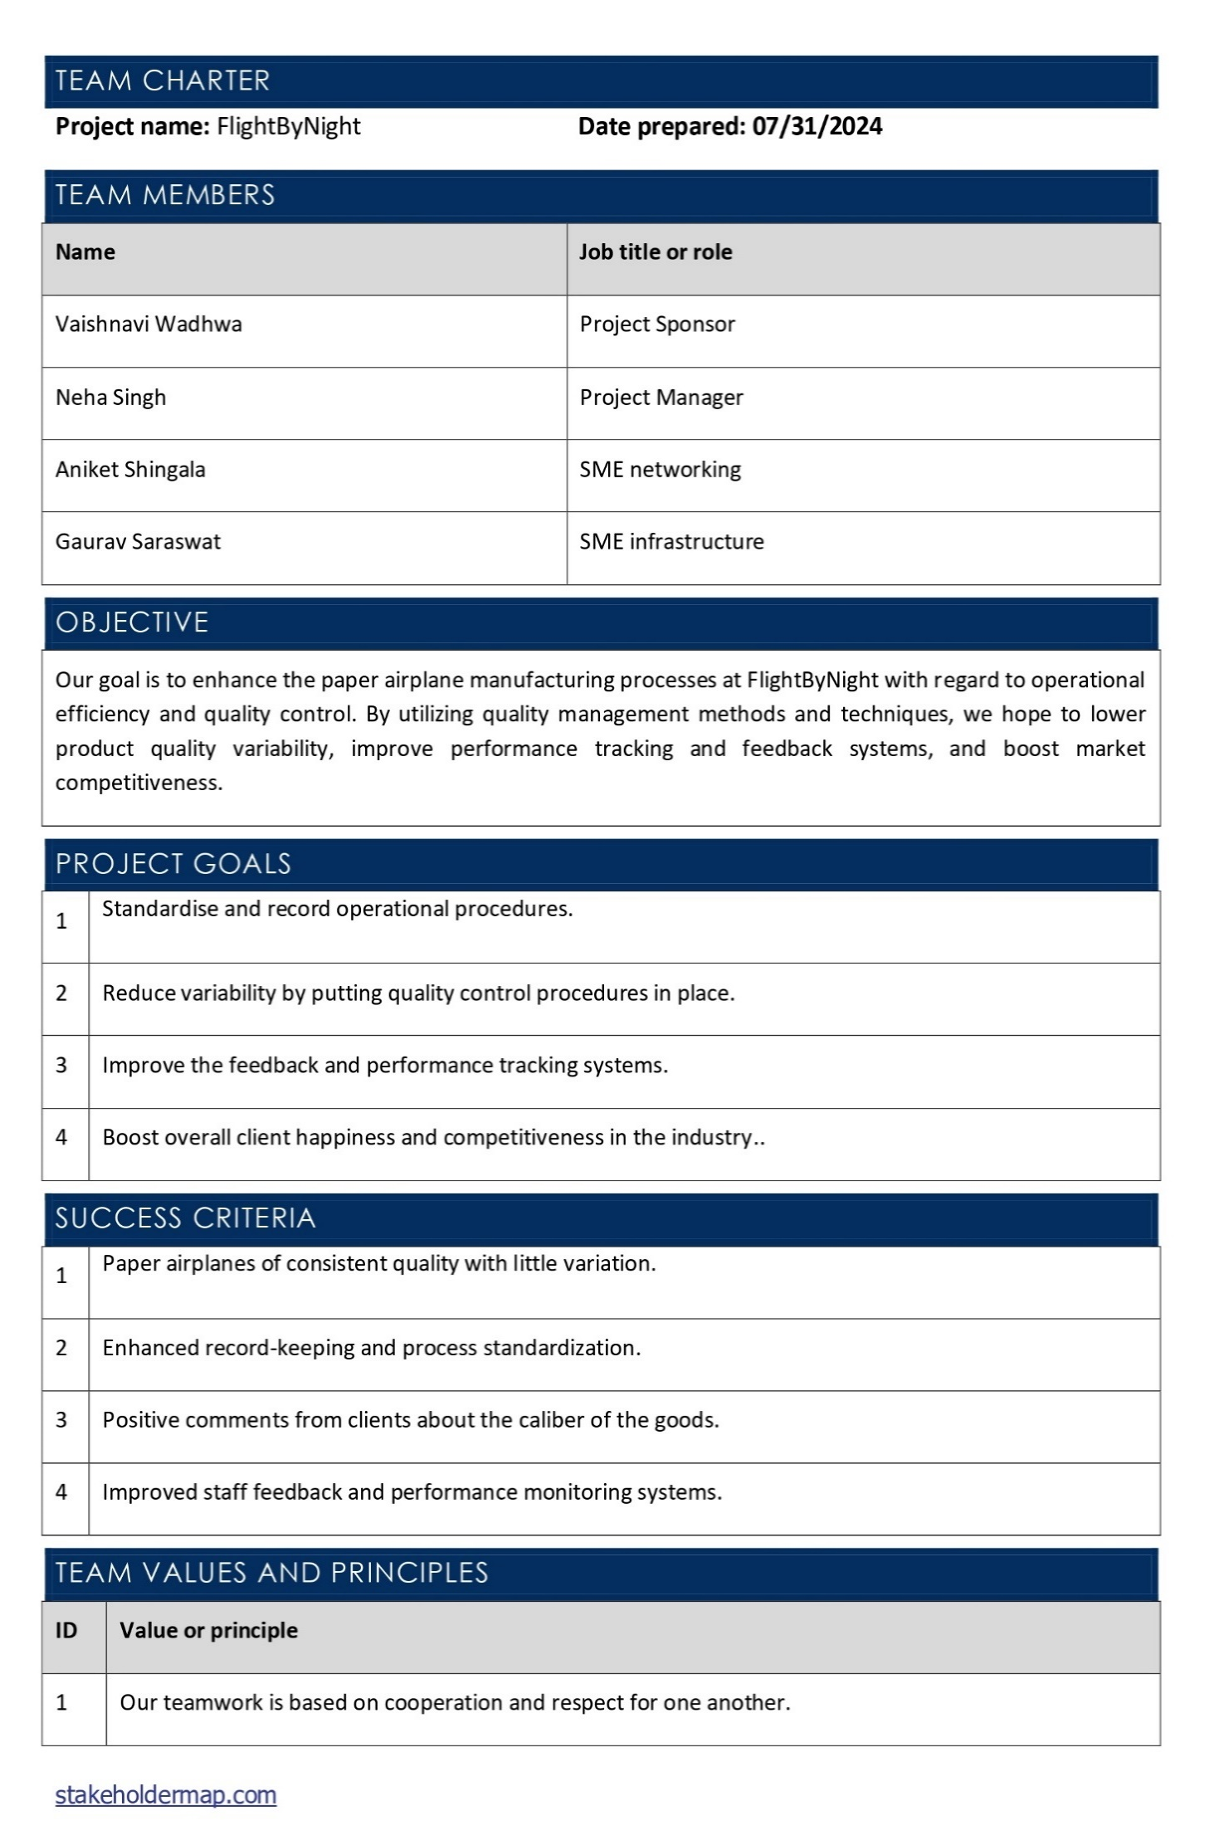
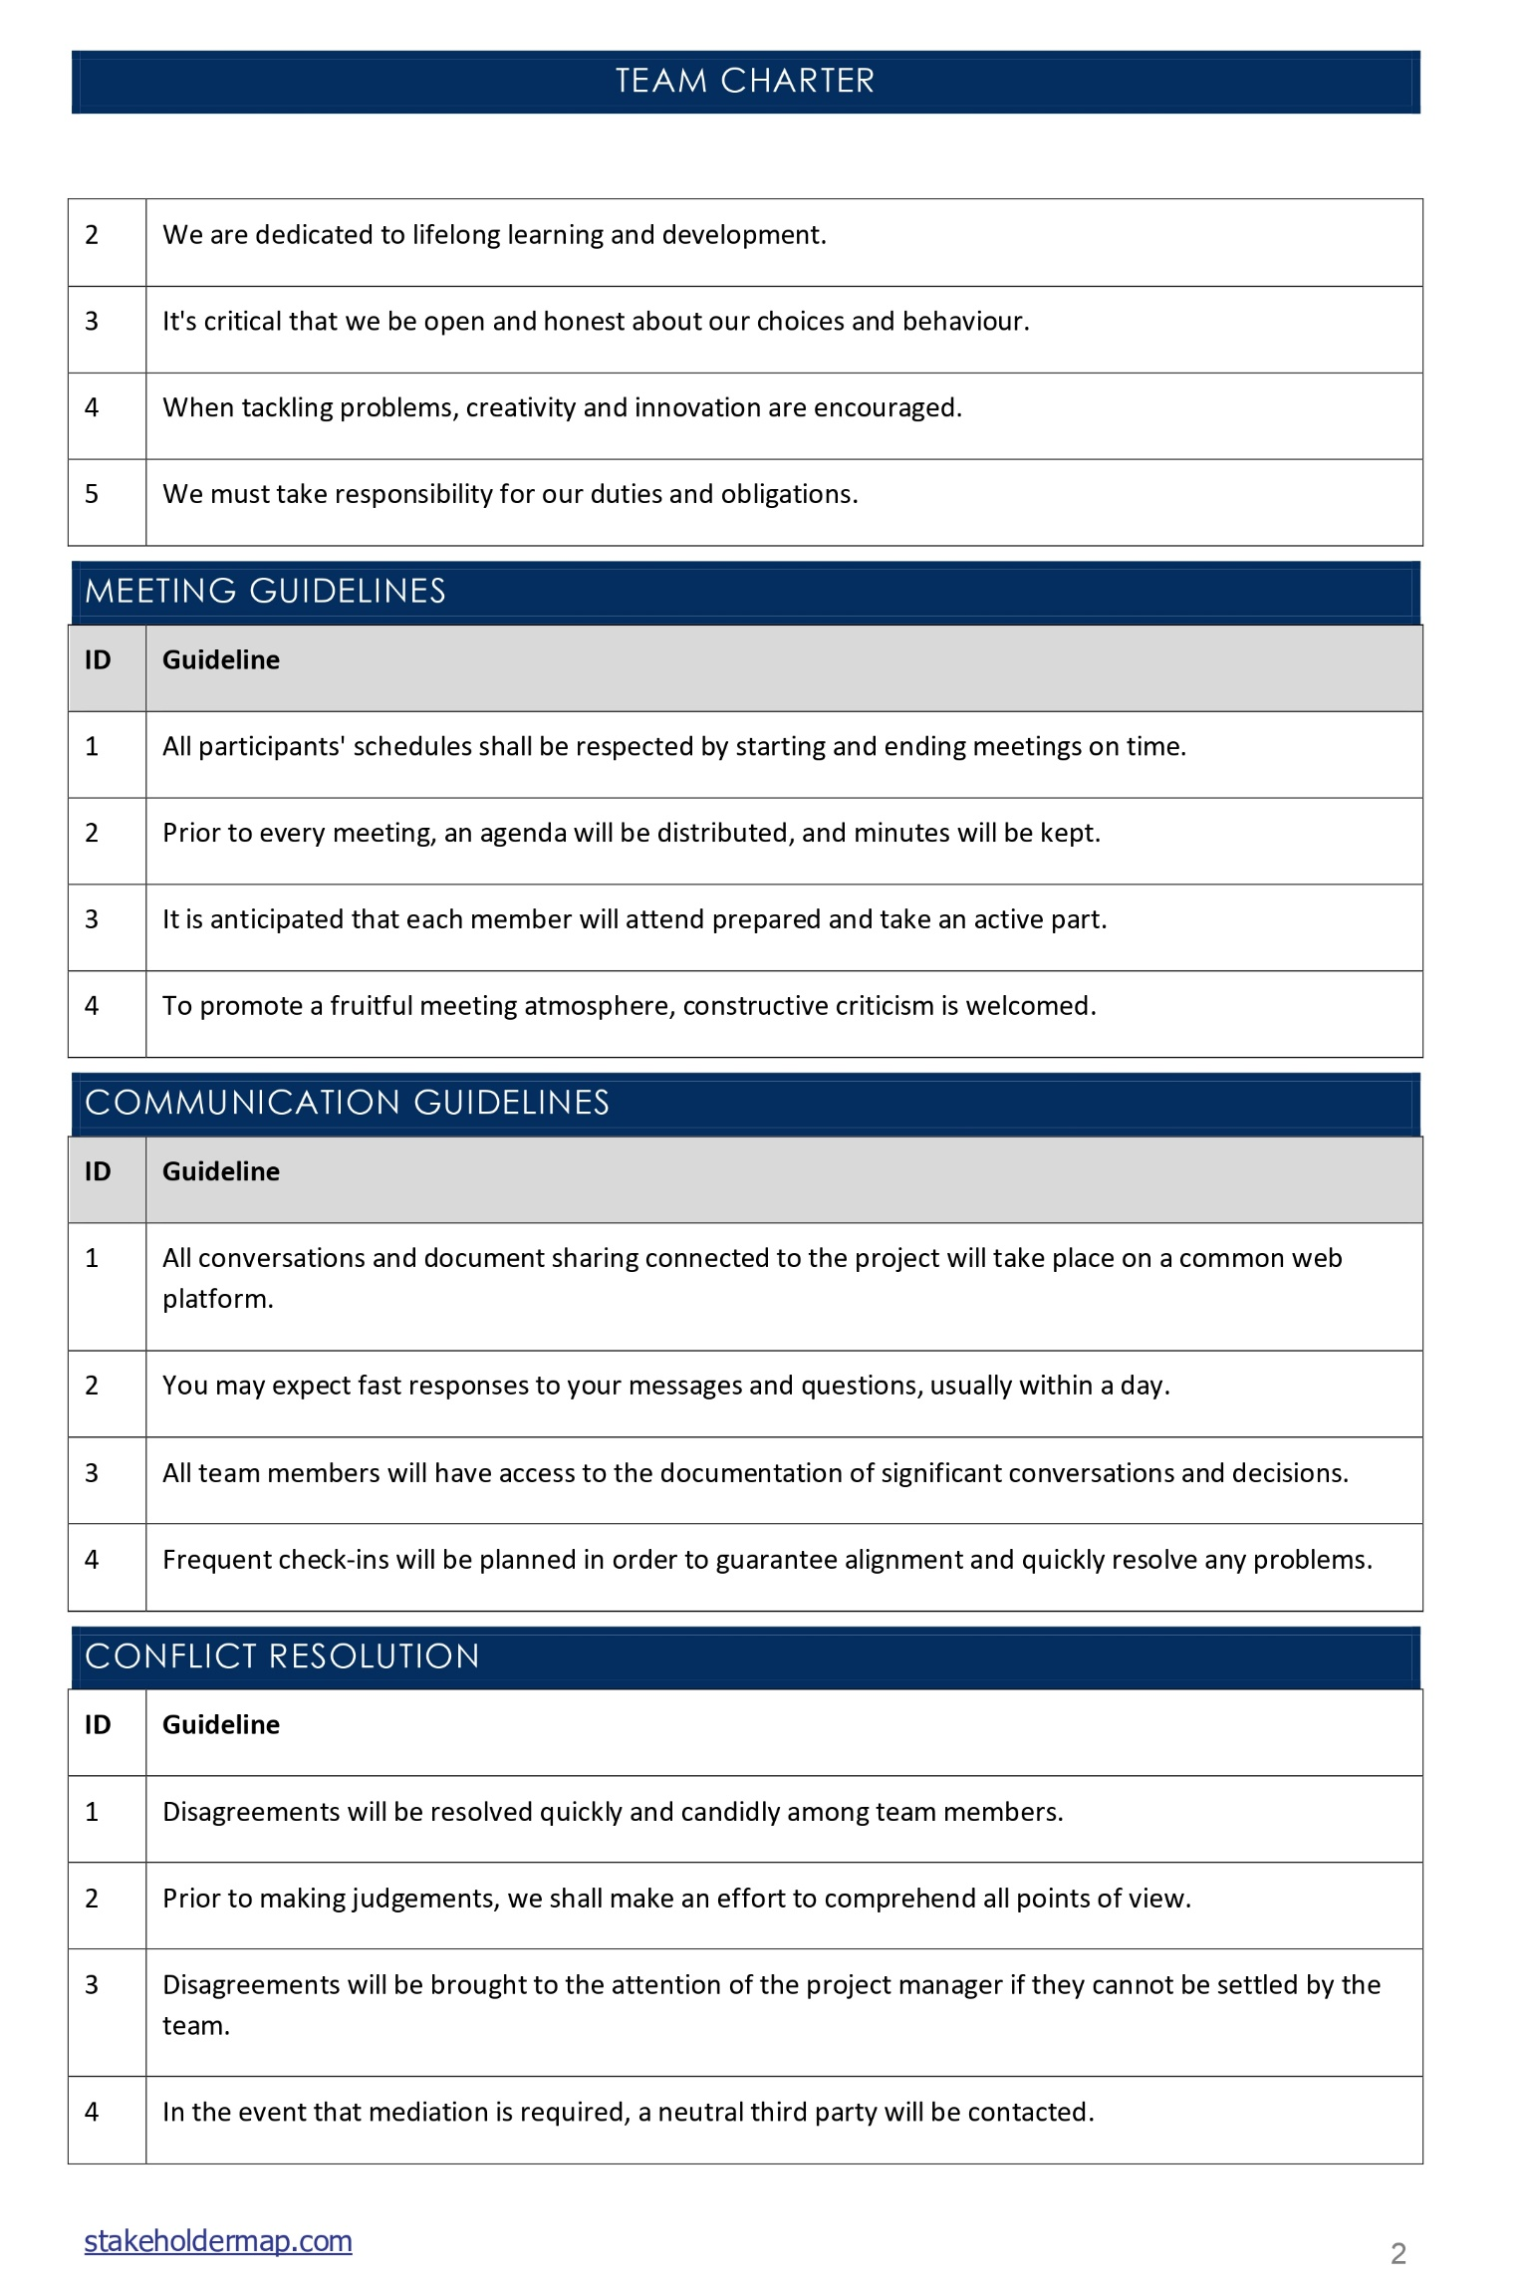
Team charter
(Tam. M, 2021, p. 1)
Notes:
Objective Goals Success Criteria

Slide 4
Flowcharts
Here, we can observe that steps 3, 5 & 8 in Advanced model are additional when comparing to classic model.

Slide 5
Problems and Solutions
Problems | Techniques
Inconsistent Quality and Variability in Performance | Six Sigma - DMAIC Reasoning
Lack of Process Documentation and Standard Operating Procedures (SOPs) | Control Chart
Inefficient Order and Inventory Management | Digital Order Management System (incorporating SIPOC) Reasoning
Inadequate Performance Tracking and Feedback Mechanism | Balanced Scorecard (BSC) Reasoning
Notes:
WHY? significant quality issue and is perceived by customers as the major problem – DMAIC methodology is specifically designed to identify and eliminate variations in processes, ensuring consistent quality and performance.
routine monitoring and revised processes – Control chart - Control charts are a fundamental tool used in quality control to monitor processes and ensure they remain within defined limits
Standard customer order form → Digital order management system
Sales and Service team and sent via inter-office mail to the Airplane Build Analyst manager – no tracking – no feedback mechanism – refine SOP accordingly

Slide 6
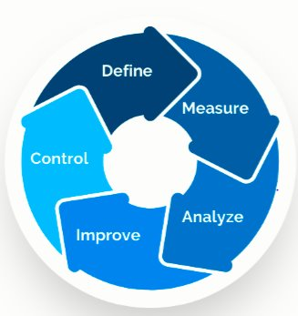
Inconsistent Quality and Variability in Performance – Six Sigma DMAIC
Define Phase
• Problem: Inconsistent quality and performance variability in paper airplanes.
• Objective: Reduce variability in flight distances and improve overall quality.
Measure
• Collect data on flight distances and defect rates.
• Establish baseline metrics and visualize data using control charts.
Analyze
• Conduct RCA to identify root causes of variability (e.g., folding techniques, paper quality).
• Use tools like fishbone diagrams to map out potential causes.
Improve
• Implement standardized folding techniques.
• Source higher-quality paper.
•Test solutions on a small scale and refine as needed.
Control
• Continuously monitor performance using control charts.
• Update SOPs and conduct regular training sessions to maintain standards.
(Conestoga College, 2024c, p. 13)
Notes:
HOW?
Six Sigma's DMAIC (Define, Measure, Analyze, Improve, Control) methodology is specifically designed to identify and eliminate variations in processes, ensuring consistent quality and performance

Slide 7
Lack of Process Documentation and Standard Operating Procedures (SOPs) – Control Chart
(Conestoga College, 2024d, p. 30) (Vertex42.com, 2024, p. 1)
Notes:
Develop SOPs:
Based on the findings from the control charts, develop and document standard operating procedures that all analysts must follow. Include detailed instructions on folding, cutting, and assembly techniques.
Training:
Train all analysts on the new SOPs and the importance of following them to ensure consistency and quality.
Continuous Monitoring:
Continue using control charts to monitor the process and make adjustments to the SOPs as needed to maintain high-quality standards and consistency.
By implementing control charts, FlightByNight can systematically reduce process variability, leading to more consistent and high-quality paper airplanes, thereby addressing the key issue of inconsistent quality and improving their competitive position in the marketplace.

Slide 8
Inefficient Order and Inventory Management – Digital Order Management System (SIPOC)
S
I
P
O
C
Process​
After the Airplane Build manager receives and processes the client order, the sales, service personnel build and test paper airplanes. Once done, completed orders are stocked in inventory, checked by the sales team, packaged for courier collection.​
Suppliers
Providers of paper, packaging, and courier services
Inputs
Order forms, supplies for paper and packing, and inventory information
Outputs
Completed client orders, updated inventories, and bundled goods prepared for delivery.
Customers
Internal stakeholders (Sales and Service team) and customers who order paper airplanes
(Conestoga College, 2024e, p. 10)
Start
Step 1
Step 2
Step 3
Step 4
Step 5
End
Notes:
SIPOC- Identify the process inputs supplied by the suppliers and the process outputs used by the customer help identify requirements for data collection
Benefits of SIPOC:
• Clarity: Gives a concise synopsis of the whole procedure, emphasising all important components.
• Identification of Inefficiencies: Assists in locating order and inventory management process bottlenecks and inefficiencies.
• Better Communication: By giving team members a common understanding of the procedure, this promotes improved communication.
• Process Improvement Foundation: Serves as a starting point for more thorough process analysis and improvement projects.
Technique: Digital Order Management System (incorporating SIPOC) Reasoning: Implementing a digital order management system will streamline the order process, reduce errors, and improve communication between the Sales and Service team and the Airplane Build Analysts. Incorporating a SIPOC (Suppliers, Inputs, Process, Outputs, Customers) diagram will help map out the entire process and identify critical points that need attention.
Digital Order Management: Automates the order handling process, reducing reliance on manual methods like sticky notes and inter-office mail.
SIPOC: Provides a high-level view of the process, ensuring that all aspects of order management are considered and optimized.
This approach will lead to faster, more accurate order fulfillment and improved customer satisfaction.

Slide 9
Inadequate Performance Tracking and Feedback Mechanism - Balanced Scorecard (BSC)
Finance
Monitor cost savings resulting from decreased material waste and a decrease in customer grievances.
Learning and growth
Customers
More Airplane Build Analysts with training in standardized building methods.
Track advancements in customer evaluations concerning the regularity of flights.
Scorecard
Internal process
Calculate how much the flying distance standard deviation has decreased.
(Conestoga College, 2024b, p. 32)
Notes:
Technique: Balanced Scorecard (BSC) Reasoning: The Balanced Scorecard (BSC) is a strategic planning and management system that can track performance metrics and link them to the company's overall strategy. By using BSC, FlightByNight can:
Track individual performance of Airplane Build Analysts.
Measure key performance indicators (KPIs) related to quality, speed, and customer satisfaction.
Align employee performance with company goals and customer expectations.
Analyze and interpret feedback to identify areas for improvement.
BSC provides a structured approach to performance management, ensuring continuous improvement and alignment with strategic objectives.

Slide 10
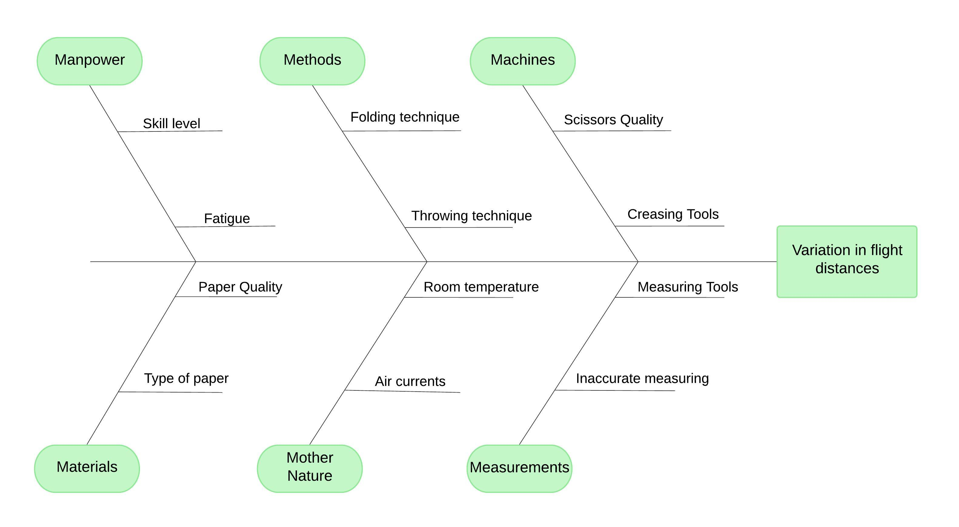
Fishbone diagram
(Conestoga College, 2024c, p. 28)

Slide 11
Deciding airplane model
Classic model travels longer distance with less variance and standard deviation compared to Step up model.

Slide 12

Documenting the Design Features
Aniket’s Classic design chosen for its lowest standard deviation in flight distances
Key differentiators:
Precision in folding
Symmetrical wing design
Reinforced and sharp nose
Balanced body structure
Small, consistent tail folds
High-quality, uniform paper
Standardizing these features will help FlightByNight achieve consistent quality and meet customer expectations effectively.

Slide 13
Updated business process
Notes:
By implementing these updated processes, FlightByNight can ensure that all paper airplanes produced will match the recommended design, leading to reduced variability, consistent quality, and improved customer satisfaction.

Slide 14

Future recommendations
Enhance Product Consistency and Quality
Digital Transformation
Strengthen Quality Control
Invest in Employee Training
Improve Customer Engagement
Conduct Regular Competitive Analysis
Foster Innovation and Product Expansion
Develop Customer Loyalty Programs
Optimize Operational Efficiency
Enhance Marketing and Brand Awareness

Slide 15

Conclusion
By implementing these recommendations, FlightByNight can ensure consistent product quality, enhance operational efficiency, and improve customer satisfaction. Embracing digital transformation, continuous improvement, and innovation will position the company for sustainable growth and success in the competitive paper airplane industry.

Slide 16
References
Tam, M. (2021, Feb 13). Team Charter Template. Stakeholdermap.com
https://www.stakeholdermap.com/project-templates/team-charter-template.html
Microsoft. (2024). Microsoft Visio. Software
https://www.microsoft.com/en-ca/microsoft-365/visio
Conestoga College. (2024a). OPER8151 Group PresentationV6. Docx. Case Study
https://conestoga.desire2learn.com/d2l/common/viewFile.d2lfile/Database/MTU1MjMyNTUz/OPER8151%20Group%20PresentationV6.docx?ou=1124521
Conestoga College. (2024b). W-5 Ch: 5 Strategic Management for Performance Excellence. PPT
https://conestoga.desire2learn.com/d2l/le/content/1124521/viewContent/23817758/View
Conestoga College. (2024c). W-9 Ch: 2, 4, 5 Tools and Techniques Together with Case Studies. PPT
https://conestoga.desire2learn.com/d2l/le/content/1124521/viewContent/23817796/View
Vertex42.com. (2024). Control Chart Template
https://www.vertex42.com/ExcelTemplates/control-chart.html
Conestoga College. (2024d). W-10 Ch: 2, 4 More on Tools and Techniques for process improvement. PPT
https://conestoga.desire2learn.com/d2l/le/content/1124521/viewContent/23817797/View
Conestoga College. (2024e). QUAL8346 - Business Process Flow Analysis I Week 4. PPT
https://conestoga.desire2learn.com/d2l/le/content/1002388/viewContent/21970587/View
Group 1. (2024, July 30). OPEX - Group Exp. Excel Worksheet
OPEX - Group Exp.xlsx

